Slide 1
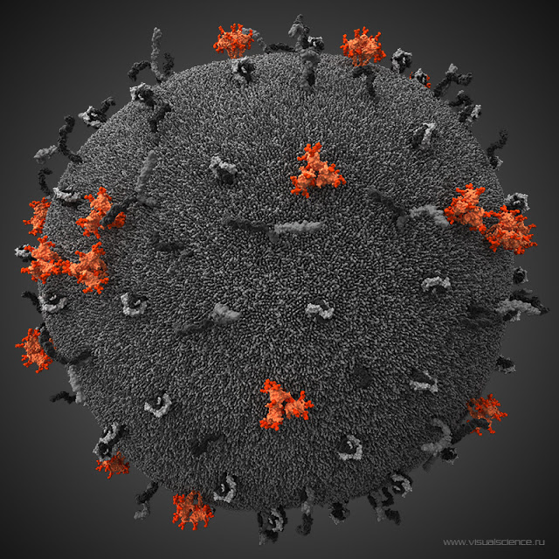
Stabilizing gp41 of HIV Envelope glycoprotein
Modestas Filipavicius

Slide 2
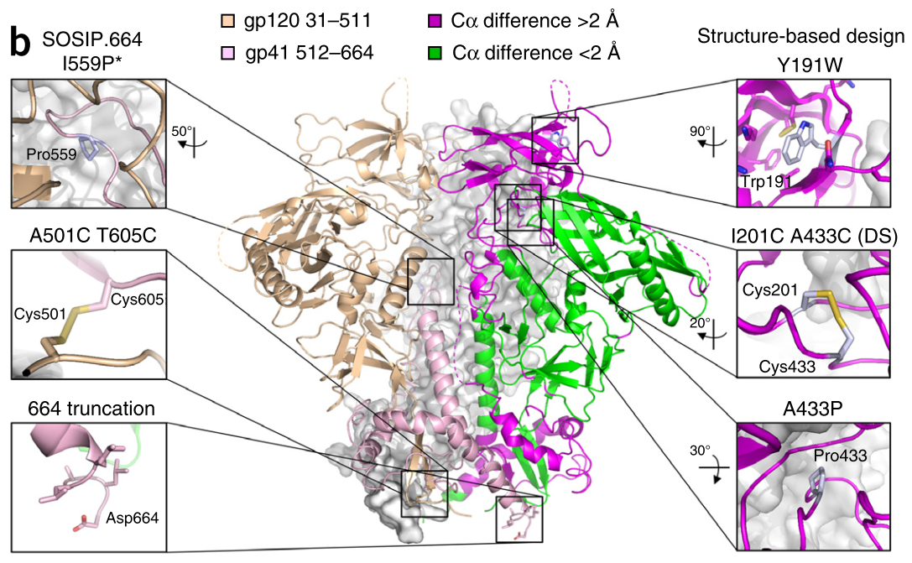

BG505 SOSIP Env – vaccine candidate
SOSIP mutations
Missing intrinsically disordered loops
gp41 is conserved and less glycosylated
Can we stabilize Env even further?
Do Kwon et al., 2015
Notes:
Stabilized by disulphide at 501 only

Slide 3
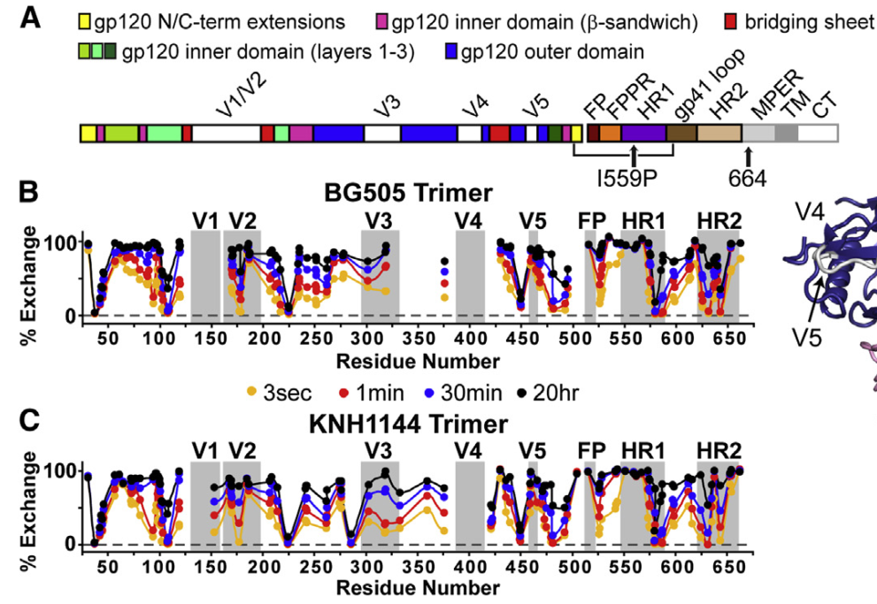
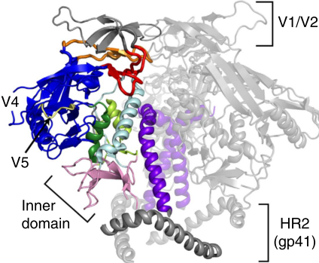
HDX reveals an unstable HR2 C-terminus
Hydrogen deuterium exchange (HDX)
15 C-terminal residues of gp41 HR2 rapidly uptake D20
lack of secondary structure
adapted from Guttman et al., 2014

Slide 4
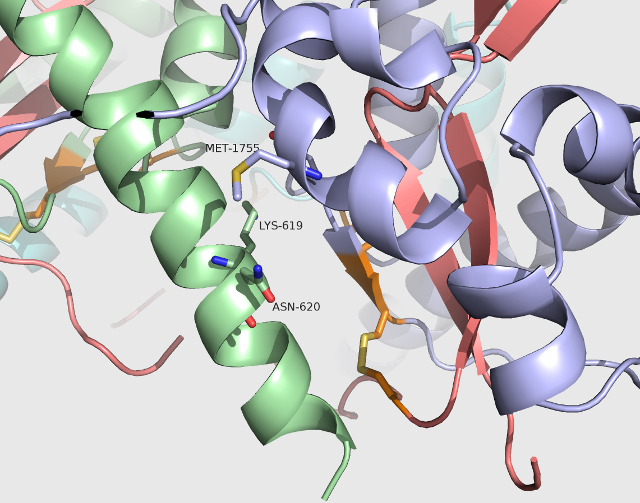
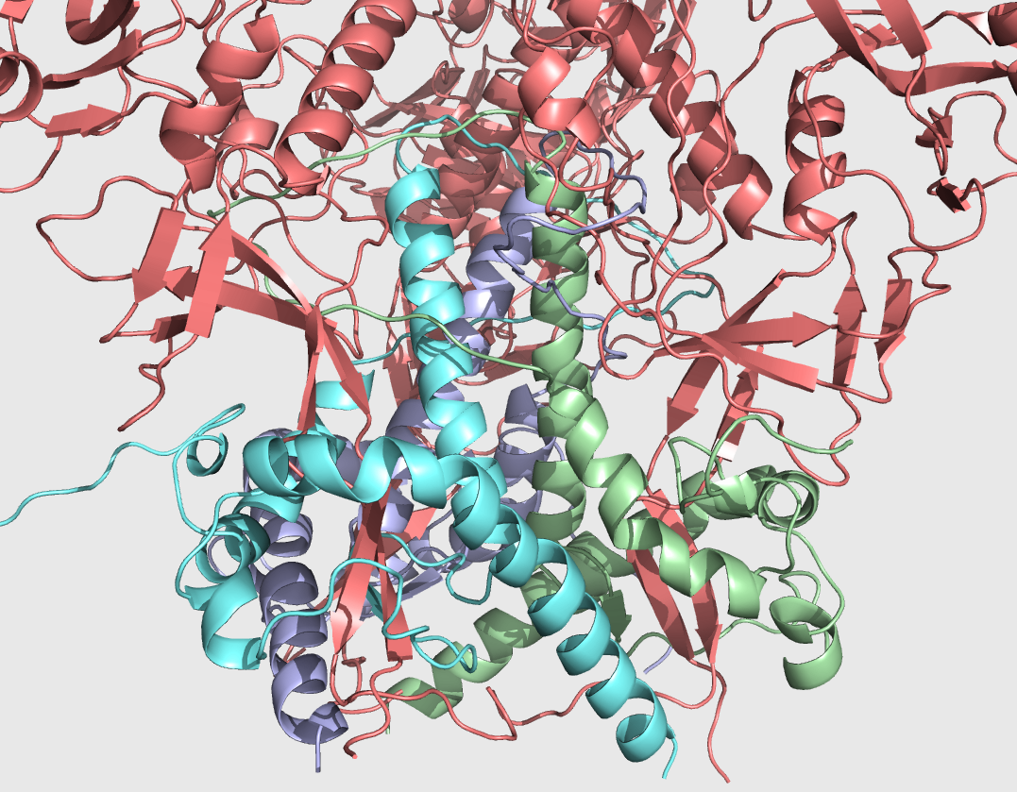
HR2 C-terminus participates in inter-protomer interactions
HR2 (residues 649-664) and opposing helix (525-540) are in close proximity
What stabilizing mutations could we introduce?

Slide 5
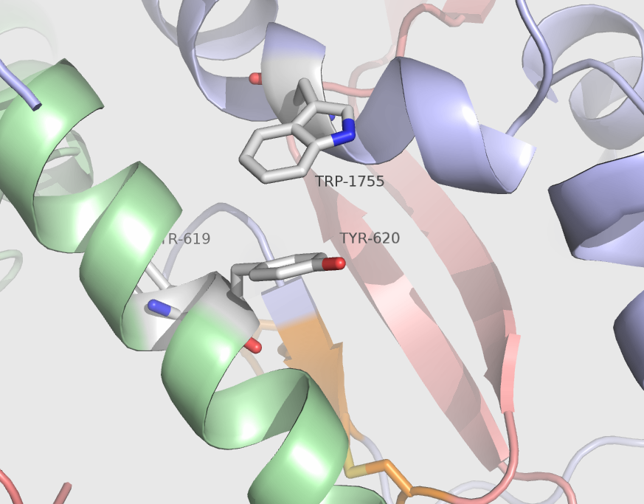
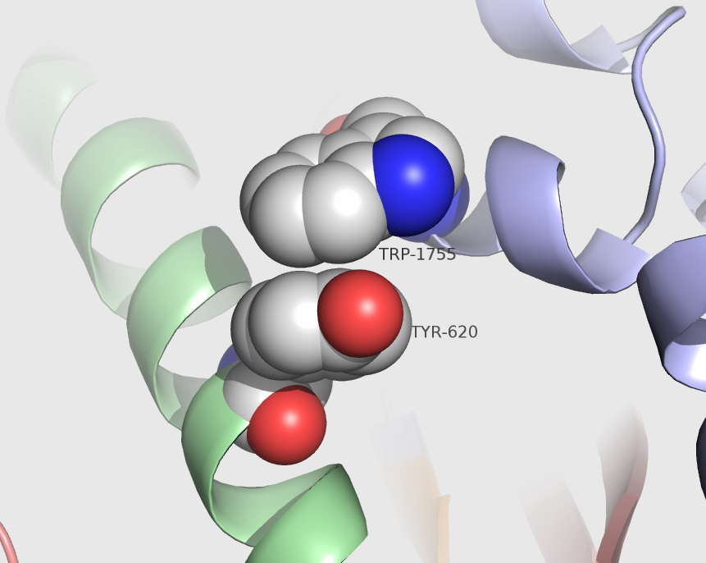
RosettaDesign on HR2
ddG monomer protocol (Kelogg et al., 2011)
Limited to gp41 region
Resfile set to ALLAA for HR2 and opposing helix residues
20 lowest scoring mutants evaluated
M535W, K655Y, N656Y triple mutant - most stable
Pi-stacking
Notes:
Allaa allows for all 20 aa except cys
E. Kellogg, A. Leaver-Fay, and D. Baker, (2011) "Role of conformational sampling in computing mutation-induced changes in protein structure and stability", Proteins: Structure, Function, and Bioinformatics. V 79, pp 830–838.

Slide 6
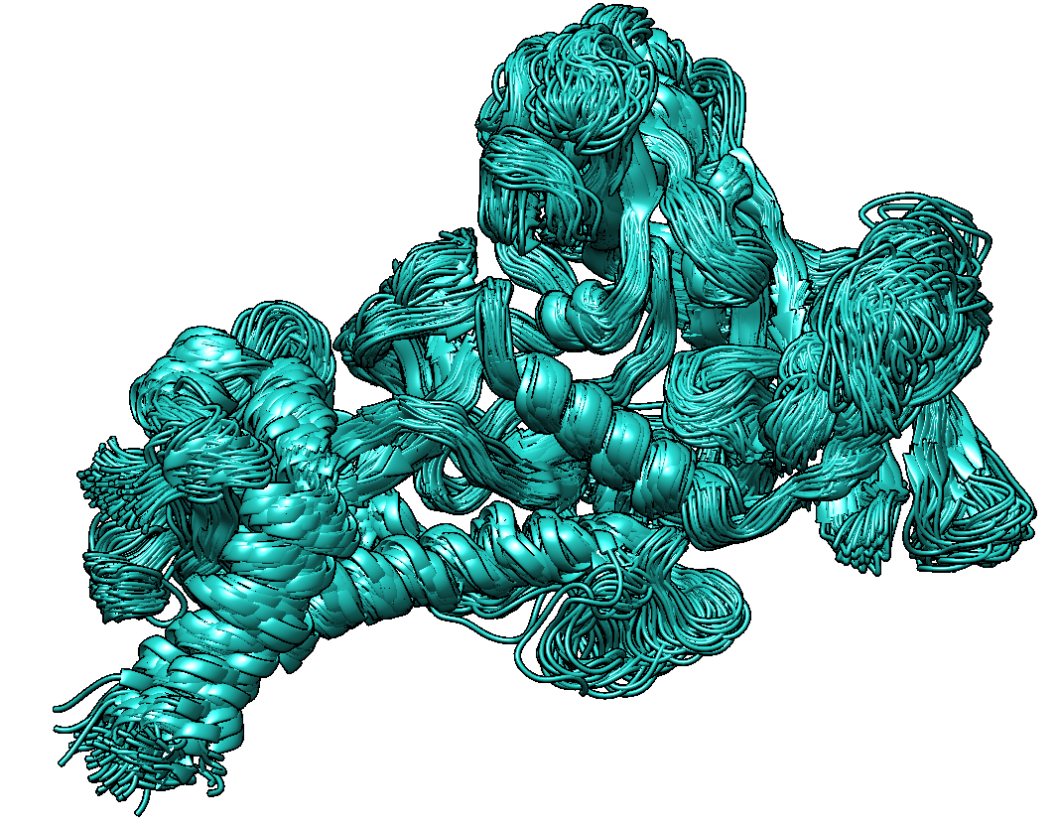
Molecular mechanics
Provides structural and dynamic info unobtainable by experiment…
…but is experimentally testable

Slide 7
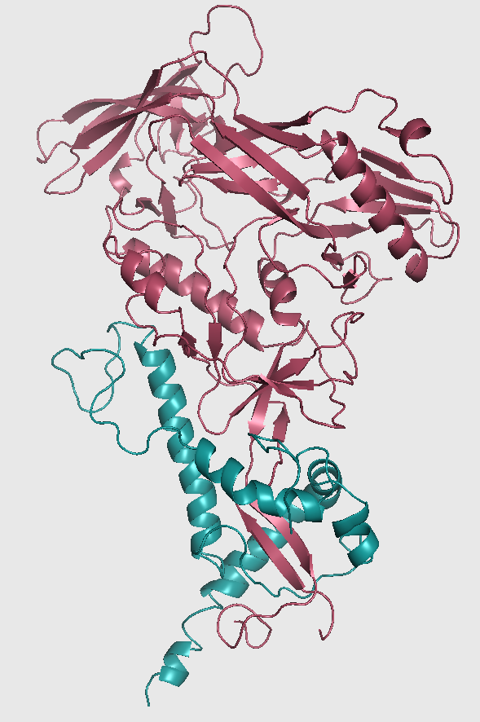
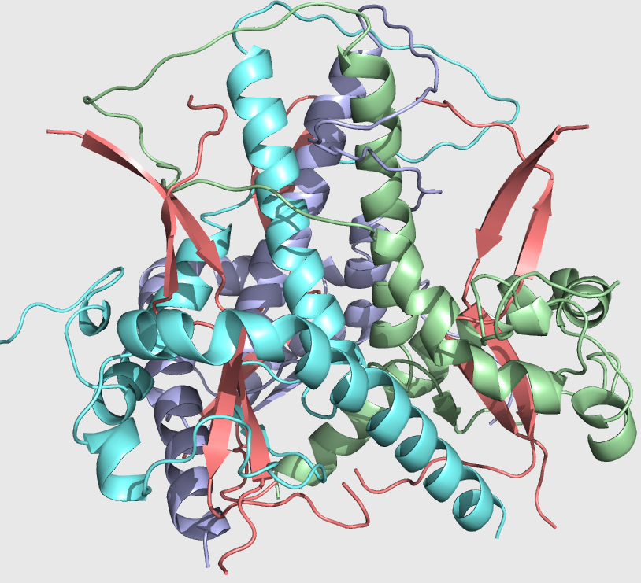
Can we simulate gp41 trimer in MD?
Problems:
Whole trimer is too big, must cut it up
Missing sequence in Xtal
gp41 is penetrated by gp120
Simplify the problem:
MD of gp41 by itself (140 resn)
gp140 (640 resn)
gp41 + truncated gp120
MD of trimer of gp41 construct
Test if M535W, K655Y, N656Y results in more stable 2* structure
Flaws in approach:
No glycans
Notes:
gp120 (chain G) 464/487 resolved
gp41 (chain B) 127/157 resolved

Slide 8
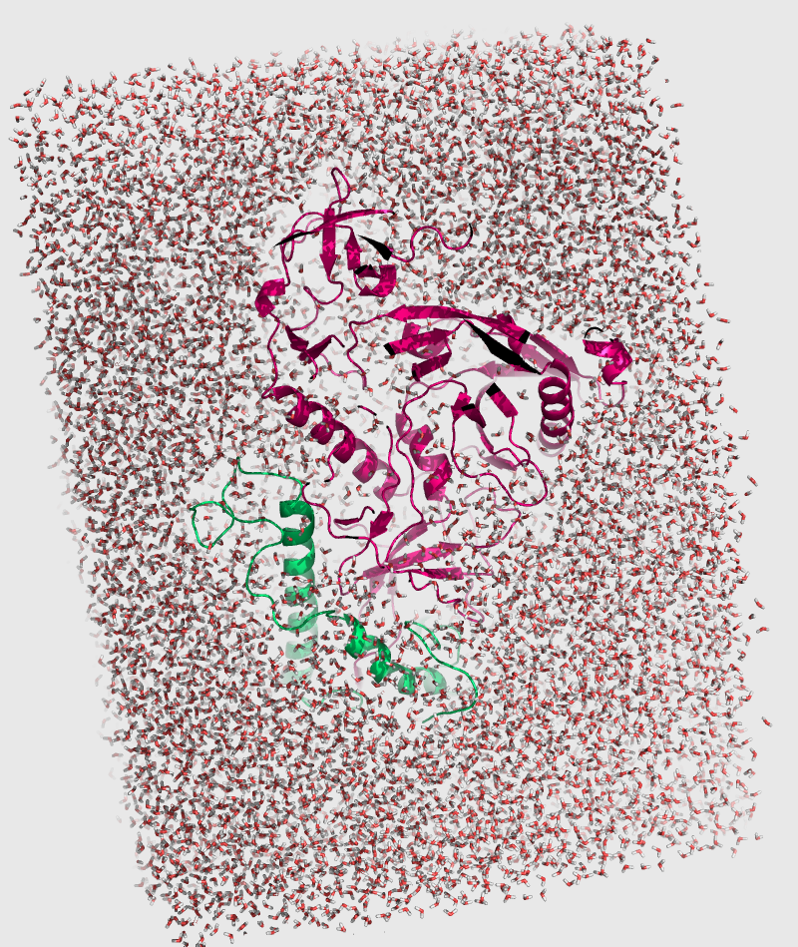
MD with ilmm
Restore missing loops (Modeller)
Fixed 11 disulphides in gp140
1000 steps of Steepest Descent minimization
Hs restored, 10 Å F3C water box,
1.8 Å from protein surface
T = 310 K
10 ns simulations, 2 fs timestep
Notes:
Flexible and polarizable three-centered water

Slide 9
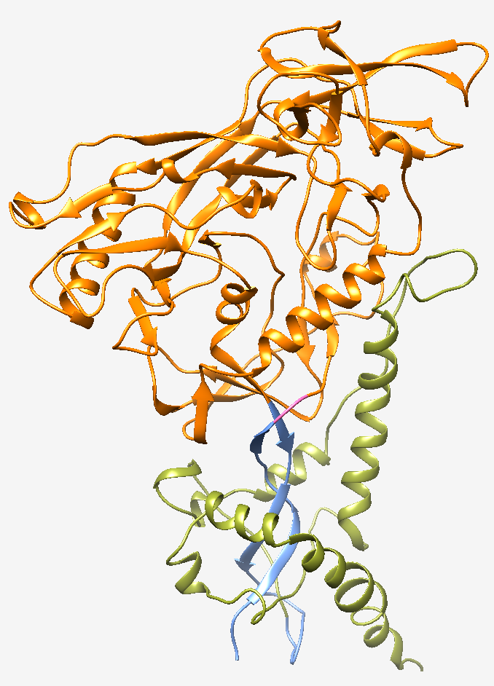
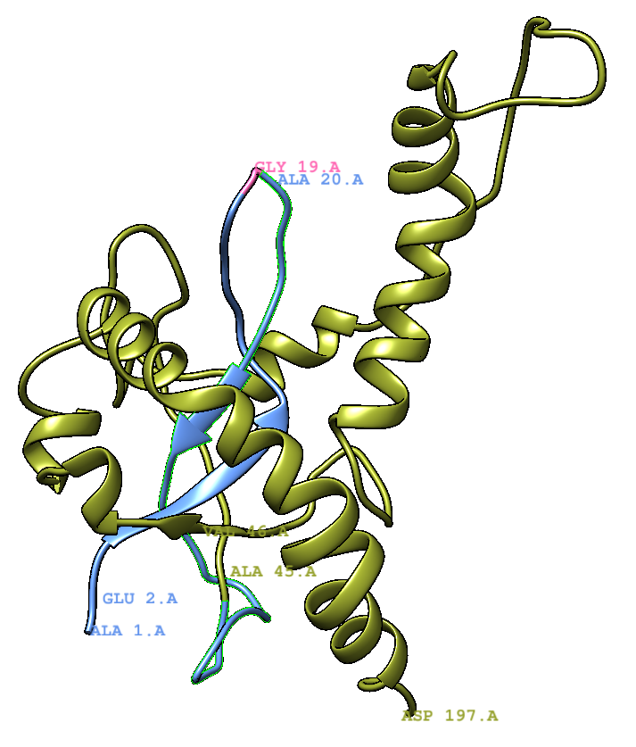
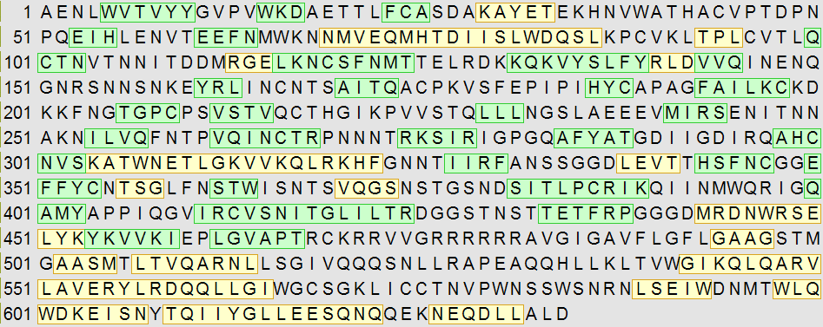
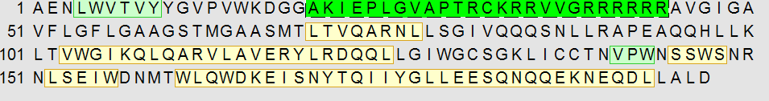
3 designs
gp140_trunc
gp140
634 residues
gp41
153 residues
gp140_trunc
197 residues
Notes:
We first cut gp120 sequence (chain G) at residue E49, resulting in
A31-E49 chain, which corresponds to the very beginning of gp120’s N-terminus. Next, A48 and
E49 were mutated to Glycines to make a polyglycine linker with another part of gp120. Third, we
excised residues T50-V488, and kept V489-R513 region, which corresponds to C-terminus of
gp120 (Figure 3). V489A was introduced to decrease beta-sheet formation next to the linker.

Slide 10
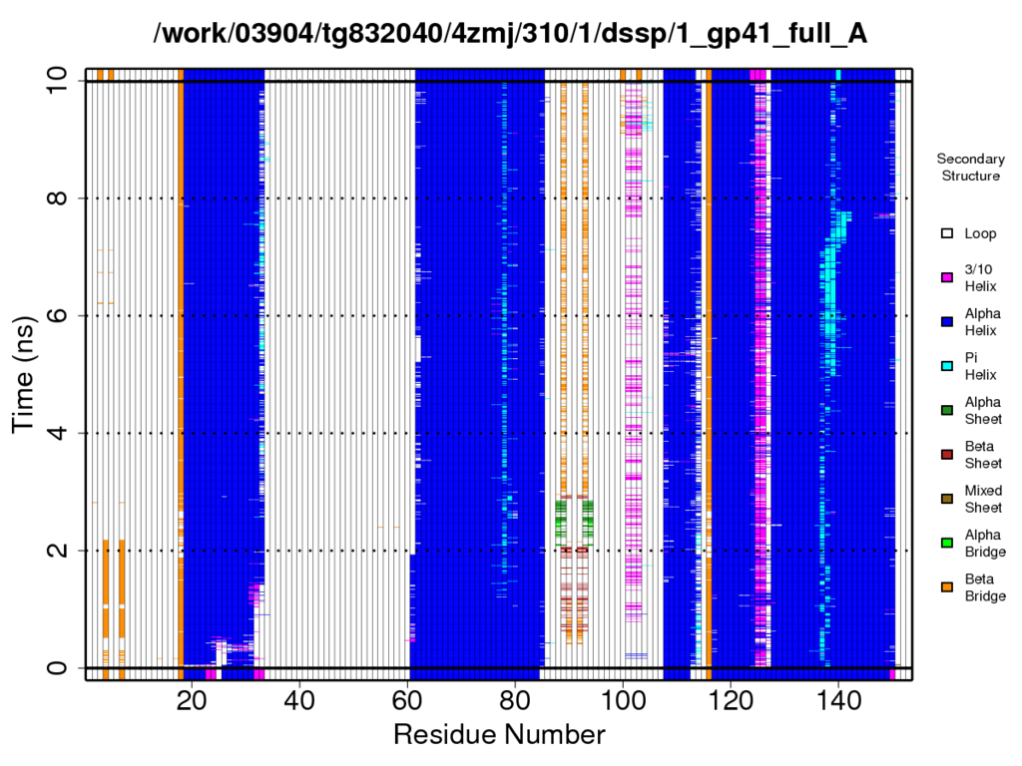
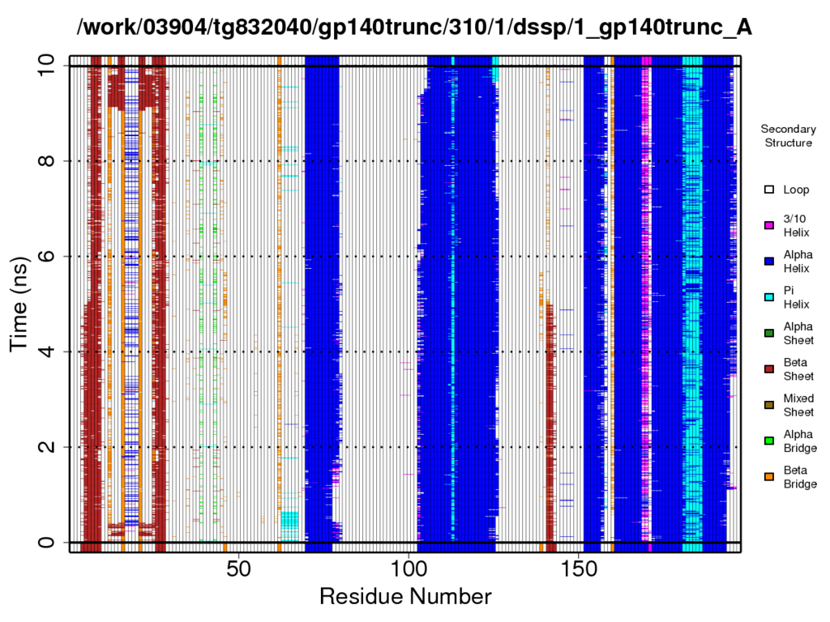
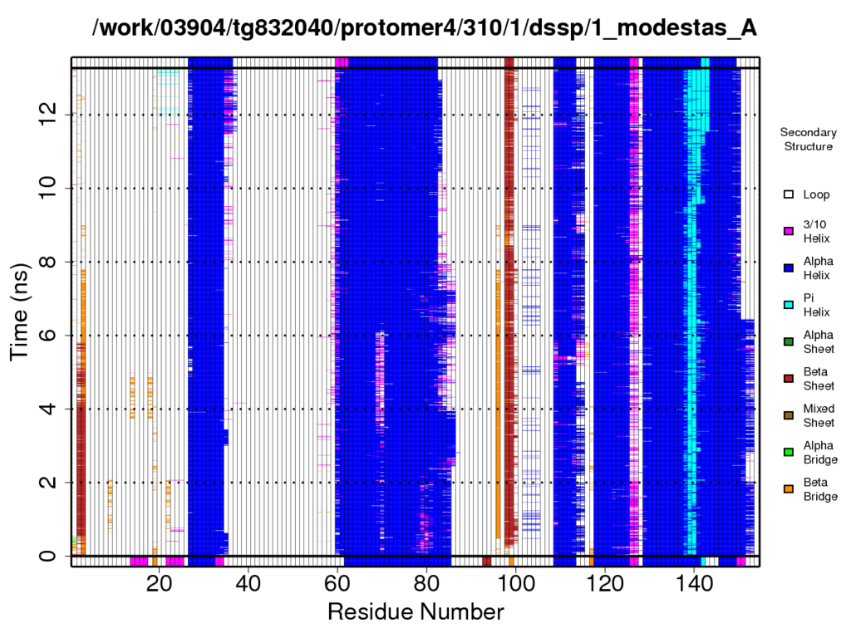
gp140_trunc is a good approximation for gp140
gp41
gp140_trunc
gp140
Notes:
Lots of salt bridges!!!! Figure 7. Secondary structure analysis indicates loss of alpha helical structure at 529-536 region of a helix that is adjacent to another protomer's HR1 (orange arrows), and is the site of M535W trimer-stabilizing mutation. Green arrows indicate sites of non-native salt bridge interactions in gp140_trunc.

Slide 11
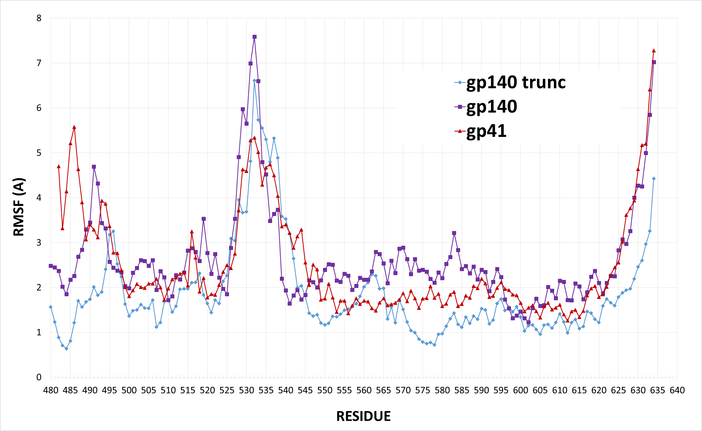
gp41_trunc moves less than gp41
Notes:
Figure 6. Drastic gp140 truncation leaving only 24 gp120 residues to stabilize gp41 produces the most stable structure. RMSF alignment of the corresponding gp41 sequence for gp140 (full gp120+gp41), full gp41, and truncated gp140. Highly disordered region L526-W541 shown in green.

Slide 12
Salt bridges E460-R555 and K458-Q547 break the HR1 helix
gp140_trunc
gp140
Notes:
HR1 helix non-native interactions in gp140_trunc. Figure 8. Transient and permanent salt bridges at E460-R555 and K458-Q547 break the HR1 alpha helix (HR1 helix is green). Residues from gp120 insert are blue.
Unique for gp140_trunc was a permanent salt bridge between E23-R118 (460-555 in 4ZMJ) and
a transient K21 and Q110 (458-547) bridge that happens in around 50% of simulation time (Figure
8, 11). This interaction results in kinking of HR1 helix, which is not observed in the other models.
HR1 is pushed upwards compared to gp140, which makes sense, since it has no clashes with its
upstairs neighbor gp120 after the latter structure was trimmed away. Hence, in the next design
iteration we might mutate out K458 to abrogate the transient salt bridge.

Slide 13
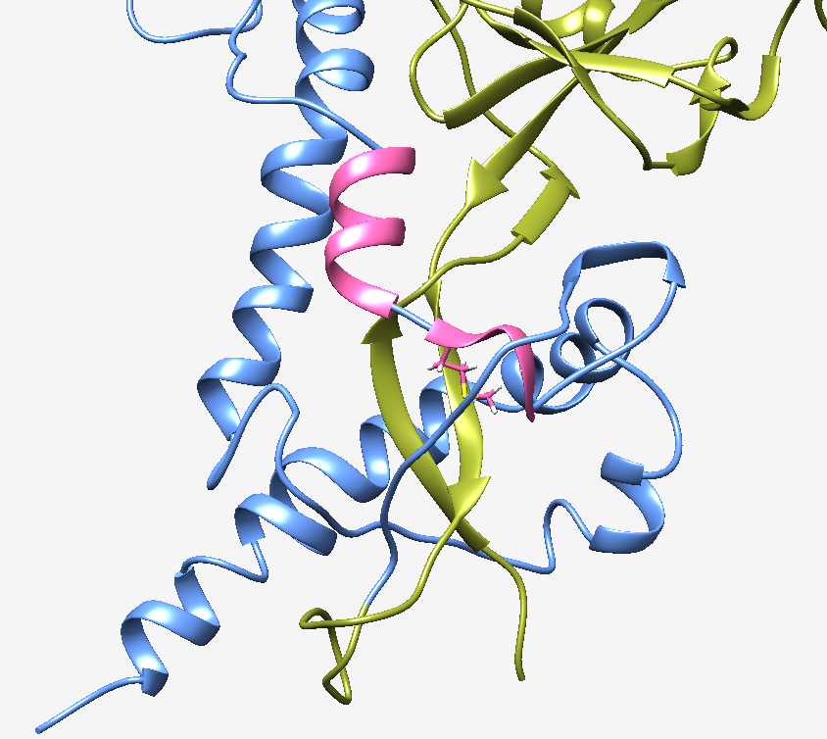
AASM(535)TLTVQARNL sequence (pink) does not have a stable helical secondary structure
Even in trimeric state, it lacks stable secondary structure as shown by HDX
HR2

Slide 14
Conclusions
HR2 is unstable
AASM(535)TLTVQARNL is unstable
These regions will benefit from stabilization
Test this on trimeric assembly
Large simulation
Using triple mutant

